Slide 1
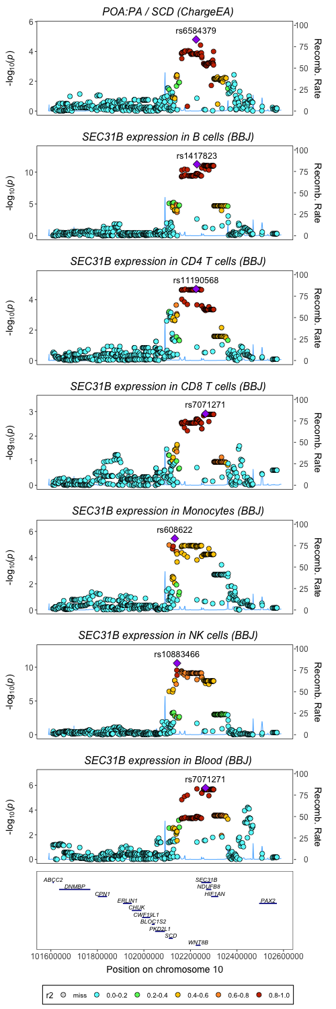
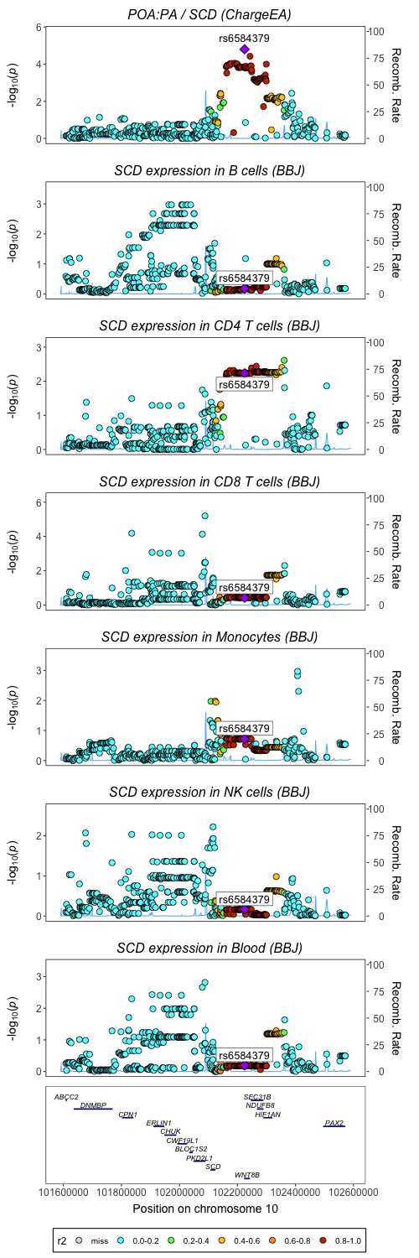
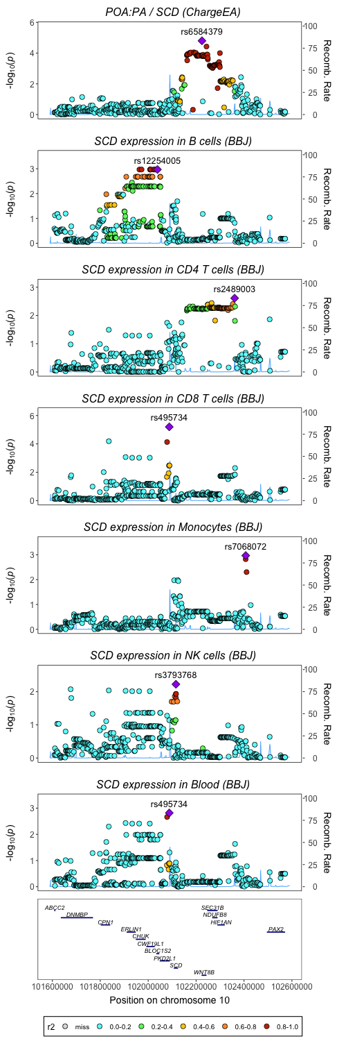
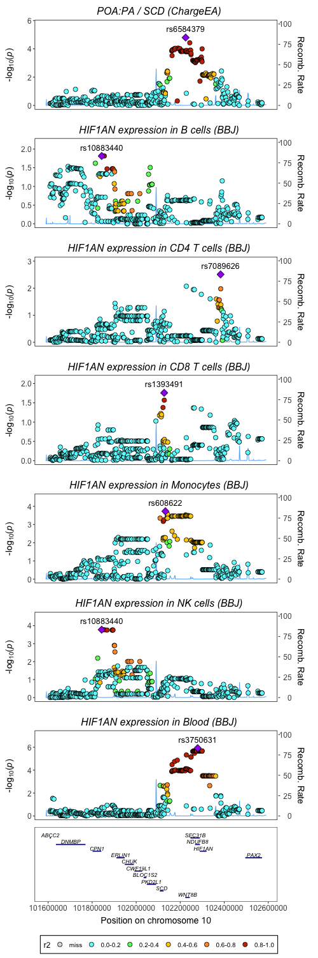
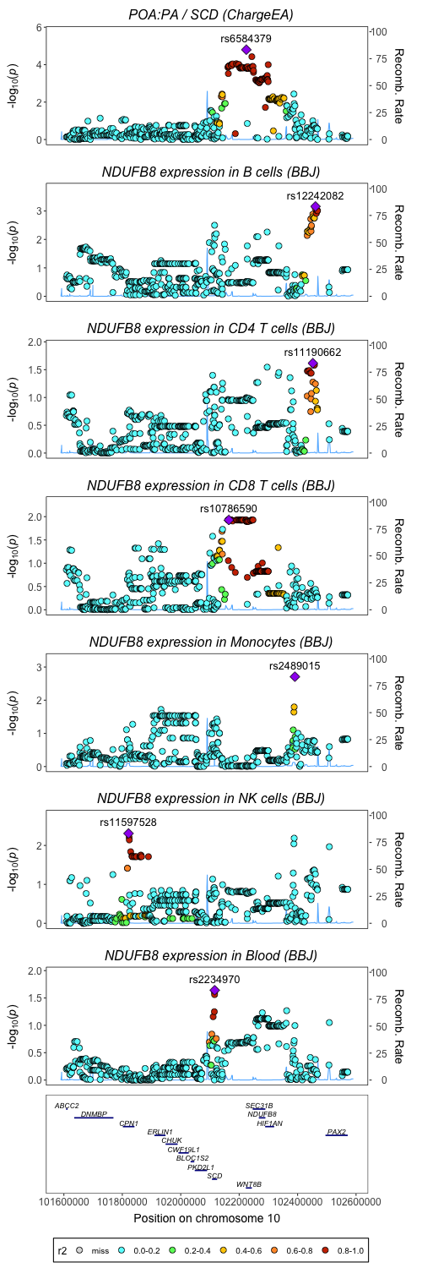
SEC31B gene expression
SCD gene expression
SCD gene expression
HIF1AN gene expression
NDUFB8 gene expression

Slide 2
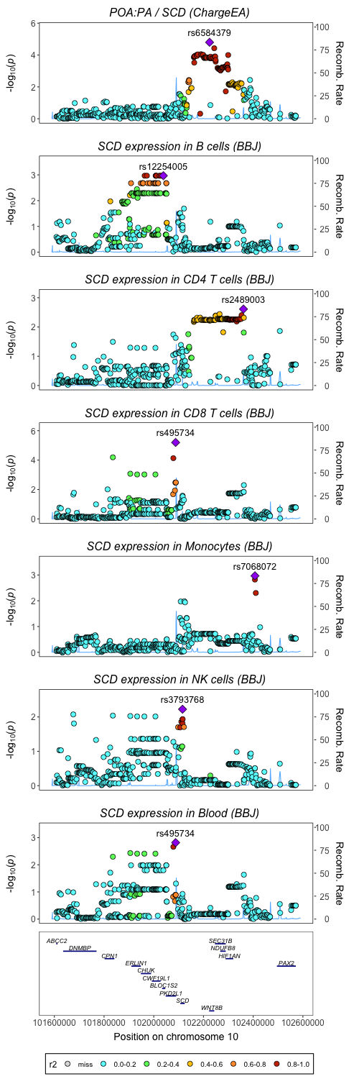


SCD gene expression
East Asians reference panel
Japan reference panel
Chinese Han Beijing reference panel
Southern Han Chinese reference panel

Slide 3
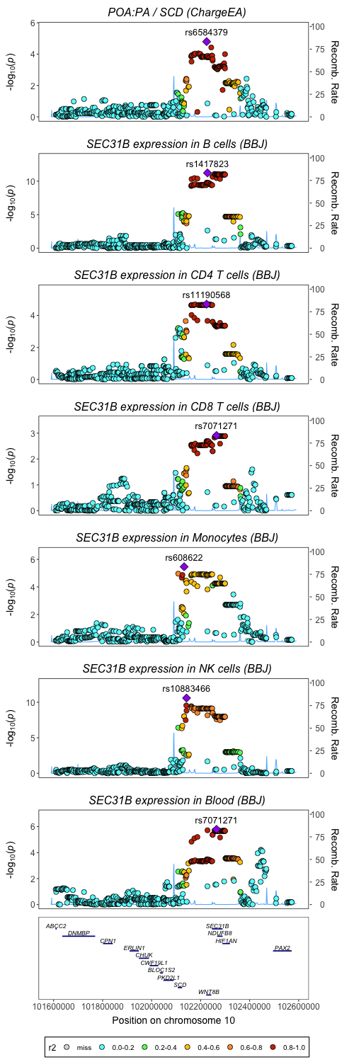

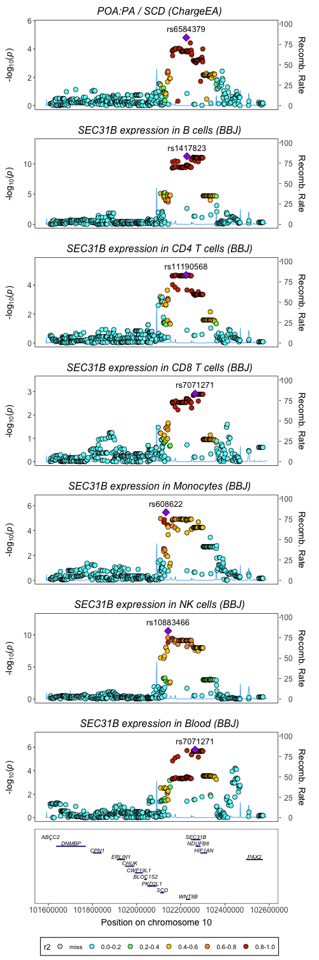
SEC31B gene expression
East Asians reference panel
Japan reference panel
Chinese Han Beijing reference panel
Southern Han Chinese reference panel

Slide 4
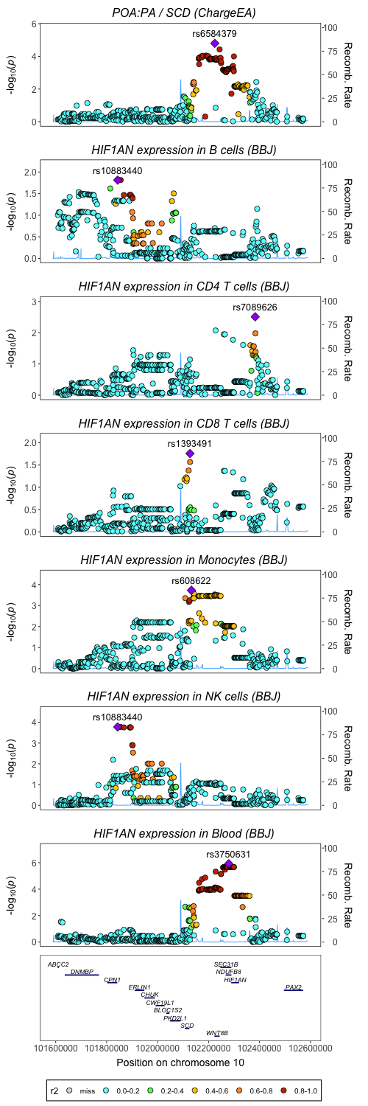

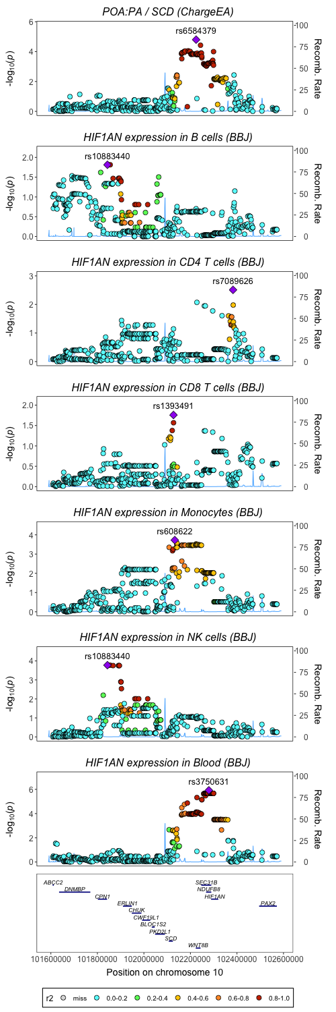
HIF1AN gene expression
East Asians reference panel
Japan reference panel
Chinese Han Beijing reference panel
Southern Han Chinese reference panel

Slide 5
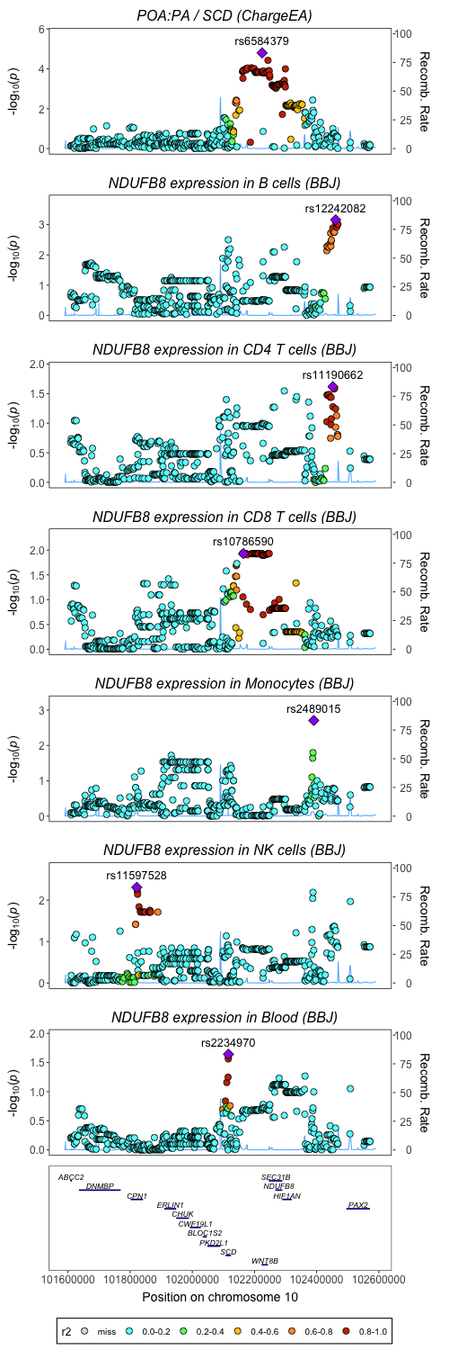
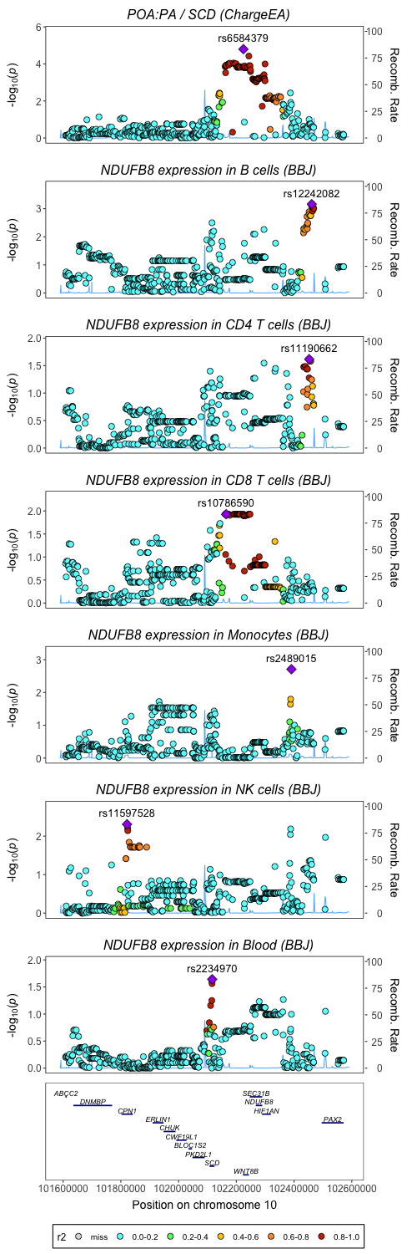
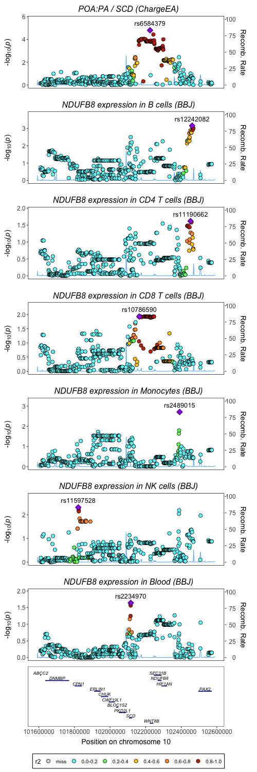
NDUFB8 gene expression
East Asians reference panel
Japan reference panel
Chinese Han Beijing reference panel
Southern Han Chinese reference panel

